Slide 1

MENTORIA ARQUITETO CLOUD
IFRAESTRUTURA COMO CÓDIGO: TERRAFORM

Slide 2
AGENDA
Desafios / soluções
Conceitos básicos
Módulos
Blueprints
Notes:
More details about Availability Zones in Azure are available at https://docs.microsoft.com/en-us/azure/availability-zones/az-overview

Slide 3
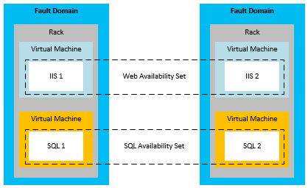
AVAILABILITY SETS
Fault domains (FD)
Update domains (UD)

Slide 4
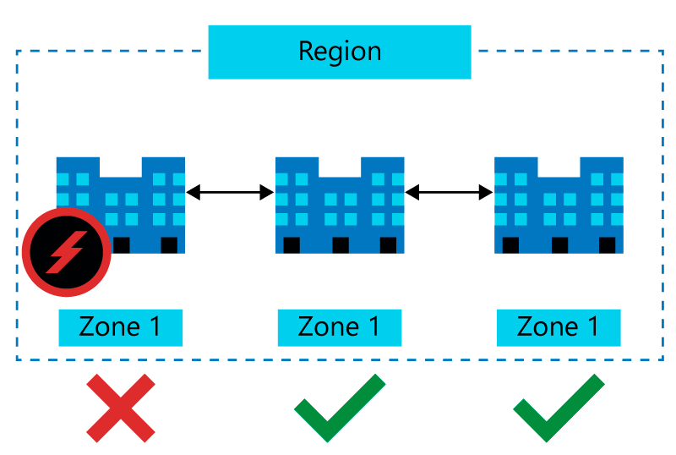
AVAILABILITY ZONES
Notes:
More details about Availability Zones in Azure are available at https://docs.microsoft.com/en-us/azure/availability-zones/az-overview

Slide 5
OPÇÕES DE LOAD BALANCERS

Slide 6
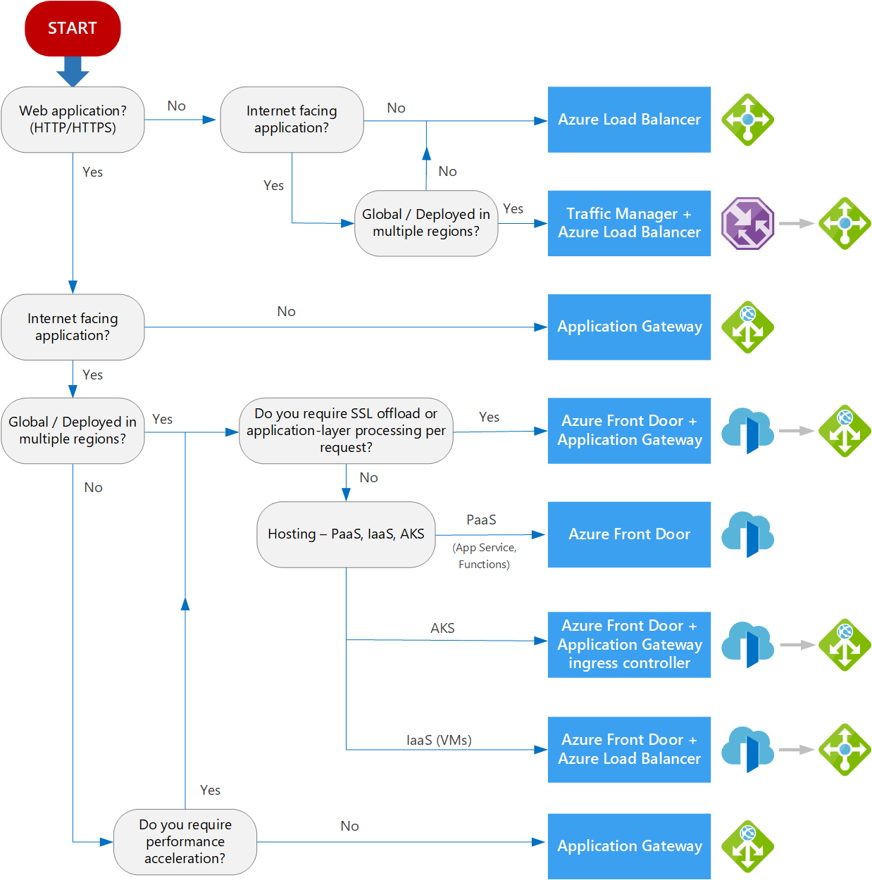
Notes:
A list of geography locations is available at : https://azure.microsoft.com/en-us/global-infrastructure/geographies/

Slide 7
OPÇÕES LOAD BALANCER AZURE
Serviço | Global/Regional | Tráfego | Front-end | Back-end
Azure Front Door | Global | HTTP/s | Public | Internet facing
Application Gateway | Regional | HTTP/s | Public/ Private | Azure VMs, VMSS, App Services, IP Address and FQDN
Traffic Manager | Global | Non-HTTP/s (DNS) | Public | Azure App Services and Public IP Address
Load Balancer | Regional | Non-HTTP/s | Public/ Private | Azure VMs and VMSS
Referências: https://docs.microsoft.com/en-us/azure/architecture/guide/technology-choices/load-balancing-overview
Notes:
A list of geography locations is available at : https://azure.microsoft.com/en-us/global-infrastructure/geographies/

Slide 8
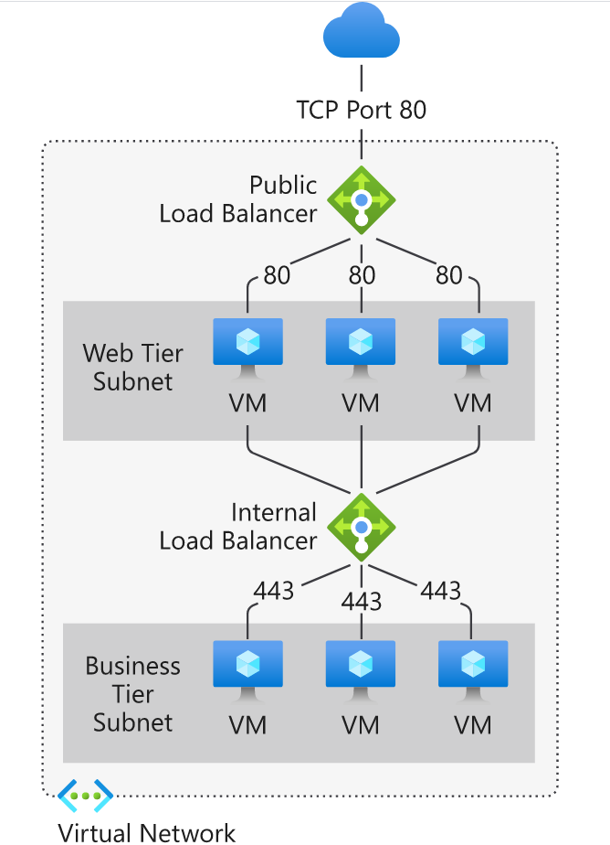
AZURE LOAD BALANCER
Public
Internal
Notes:
A list of geography locations is available at : https://azure.microsoft.com/en-us/global-infrastructure/geographies/

Slide 9
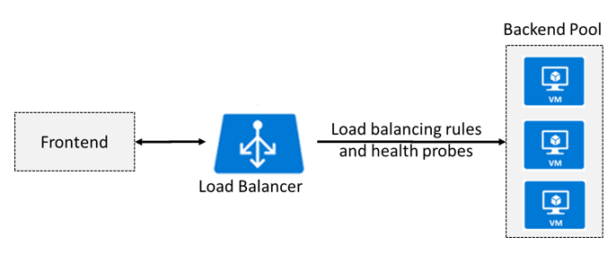
AZURE LOAD BALANCER
Frontend IP Configuration
Backend Pool
Health Probes
Load Balancing Rules
Inbound NAT Rules
Referências: https://docs.microsoft.com/en-us/azure/load-balancer/components
Notes:
A list of geography locations is available at : https://azure.microsoft.com/en-us/global-infrastructure/geographies/

Slide 10
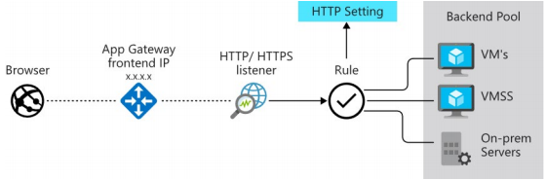
APPLICATION GATEWAY
Notes:
A list of geography locations is available at : https://azure.microsoft.com/en-us/global-infrastructure/geographies/

Slide 11
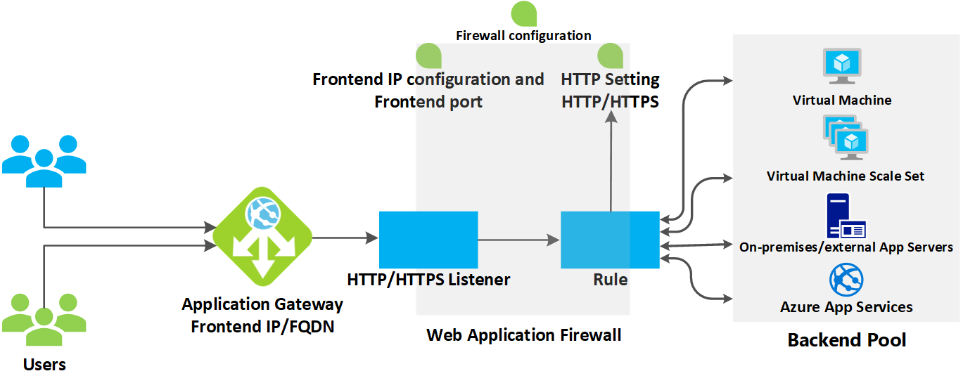
AZURE APPLICATION GATEWAY
Referências: https://docs.microsoft.com/en-us/azure/application-gateway/how-application-gateway-works
Notes:
A list of geography locations is available at : https://azure.microsoft.com/en-us/global-infrastructure/geographies/

Slide 12
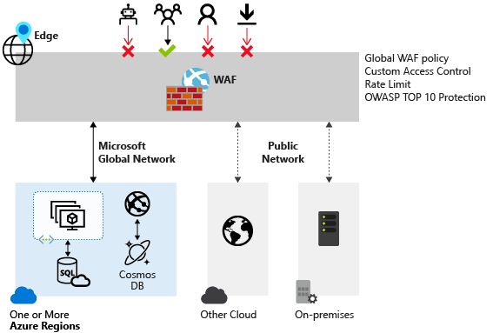
WEB APPLICATION FIREWALL (WAF)
Notes:
A list of geography locations is available at : https://azure.microsoft.com/en-us/global-infrastructure/geographies/

Slide 13
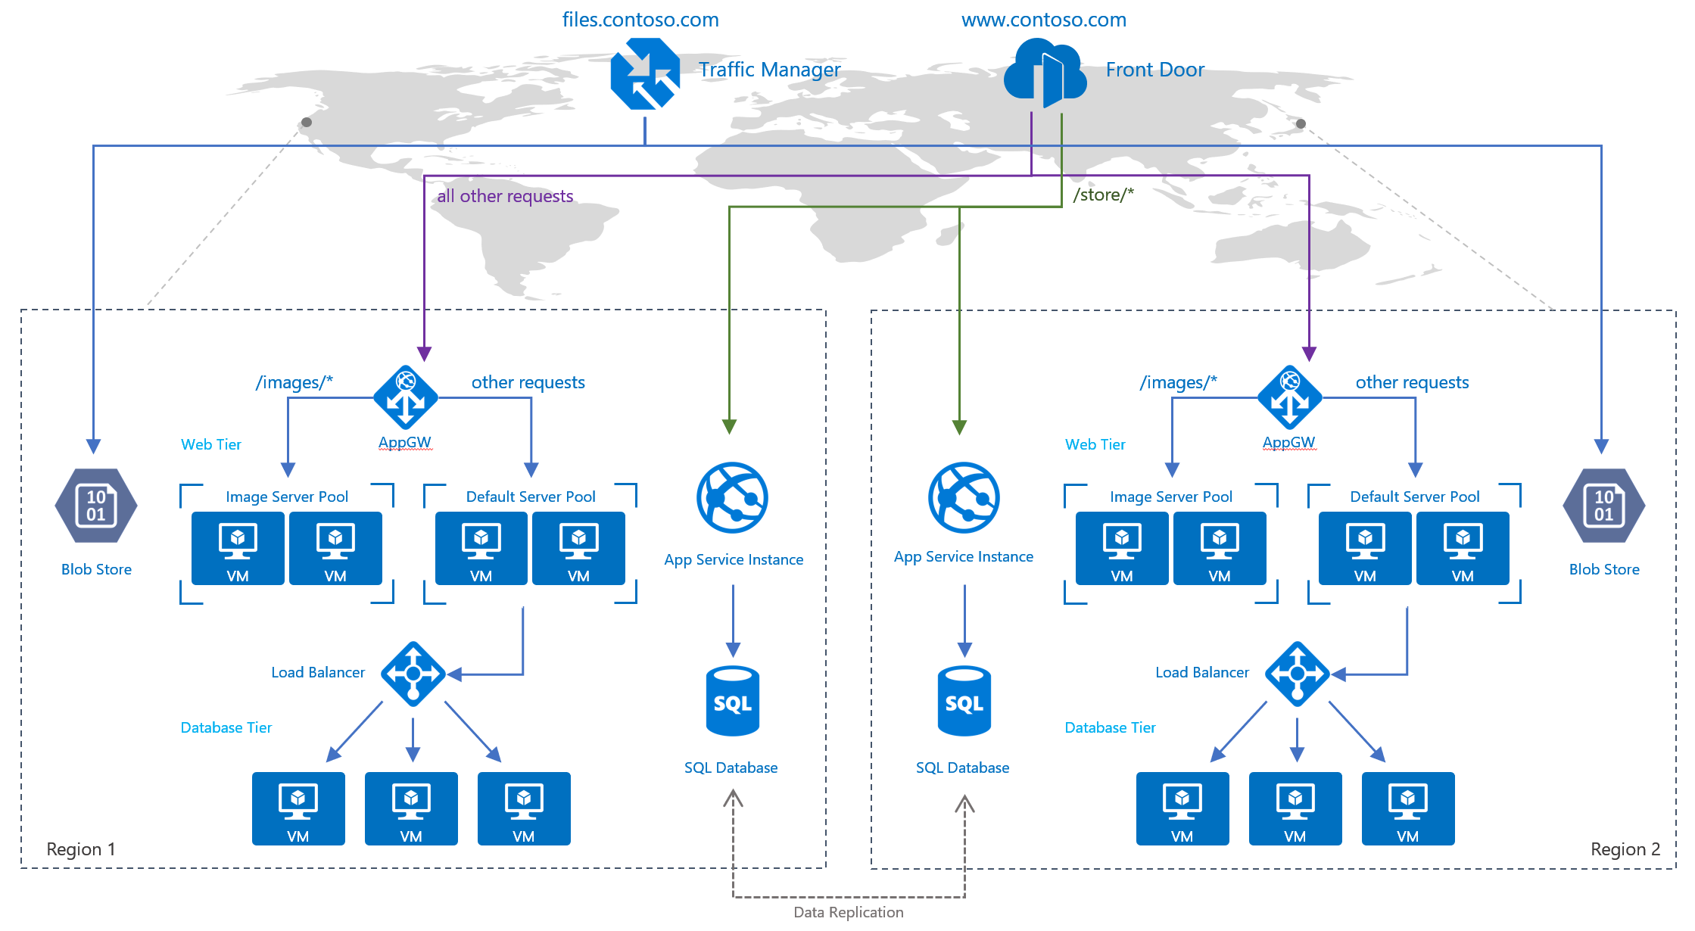
LOAD BALANCERS GLOBAL
Referências: https://docs.microsoft.com/en-us/azure/frontdoor/front-door-lb-with-azure-app-delivery-suite
Notes:
A list of geography locations is available at : https://azure.microsoft.com/en-us/global-infrastructure/geographies/

Slide 14
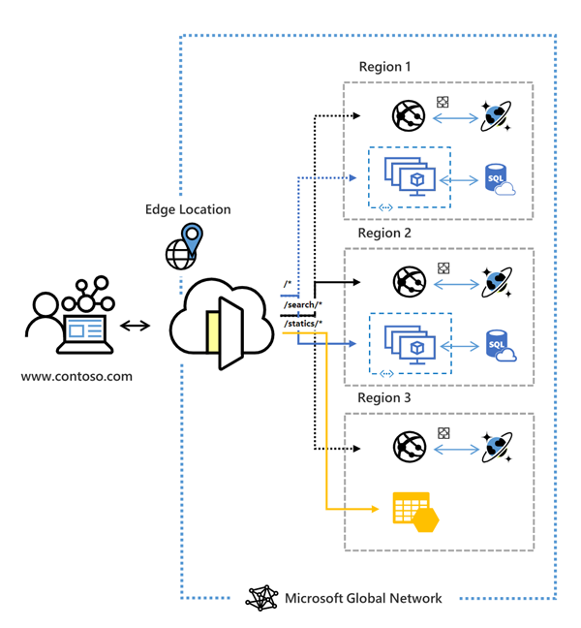
AZURE FROONT DOOR
Application delivery network (ADN)
Load Balancer (Layer 7)
Multi-region (Global)
Referências: https://docs.microsoft.com/en-us/azure/frontdoor/front-door-overview
Notes:
A list of geography locations is available at : https://azure.microsoft.com/en-us/global-infrastructure/geographies/

Slide 15
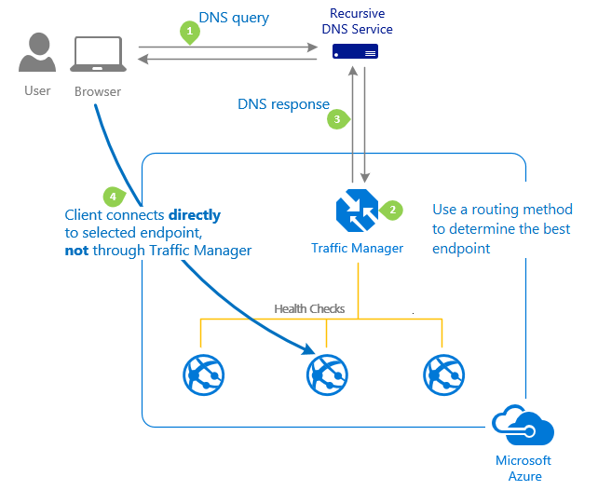
TRAFFIC MANAGER
DNS-based Load Balancer
Multi-region (Global)
Referências: https://docs.microsoft.com/en-us/azure/web-application-firewall/ag/ag-overview
Notes:
A list of geography locations is available at : https://azure.microsoft.com/en-us/global-infrastructure/geographies/

Slide 16
SESSÃO DE PERGUNTAS & MENTORIA

Slide 17
ATIVIDADES MENTORING #06
Assistir e resumir as aulas do Módulo 6 e postar resumo com #RESUMOMODULO5
Fazer atividades da trilha Arquiteto Cloud da Mentoria

